Slide 1

Synthesizing HDL code for a MATLAB algorithm
T Raja Aadhithan
M.Sc Electronic Science
IVth Semester
Roll No : 3977
Mr. Amit Birwal Prof. Mridula Gupta
Assistant Professor Head of Department
( Project Guide ) ( Project Coordinator )
Department of Electronic Science
University of Delhi - South Campus
New Delhi - 110021

Slide 2
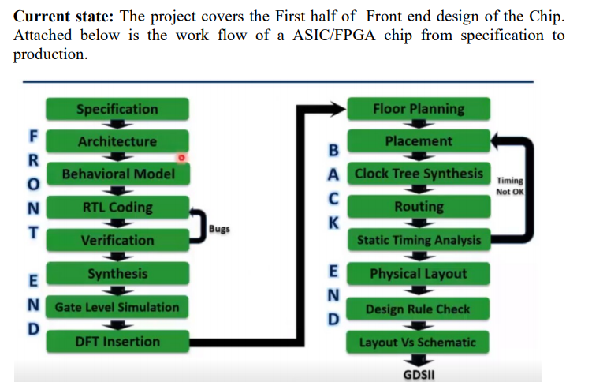
Need for Project

Slide 3
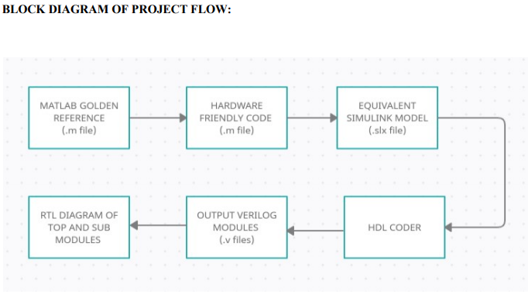
Block Diagram

Slide 4
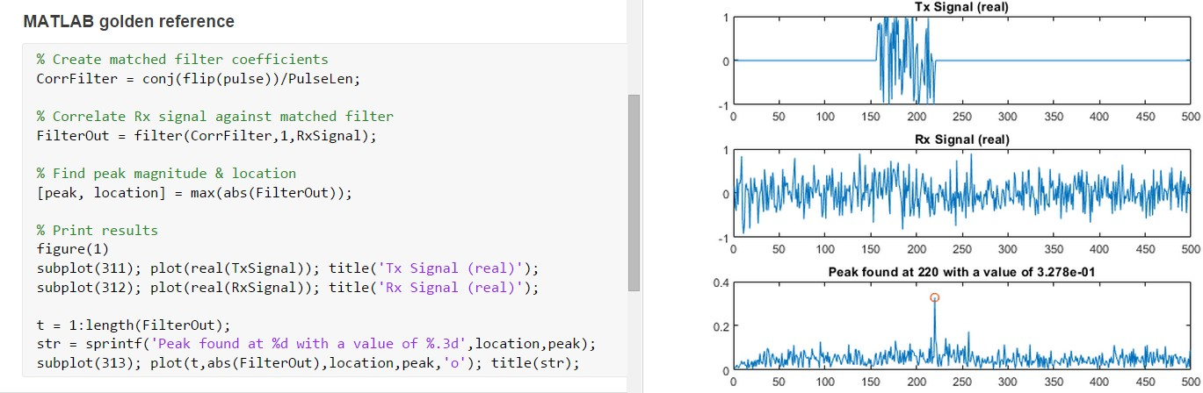
Overview
In this project, we have the MATLAB reference of a pulse detection algorithm. The algorithm detects a known waveform in a received signal using a matched filter, and finding the resulting peak. It is a commonly used technique in radar or wireless communication systems.

Slide 5
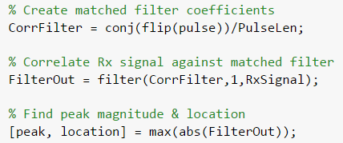
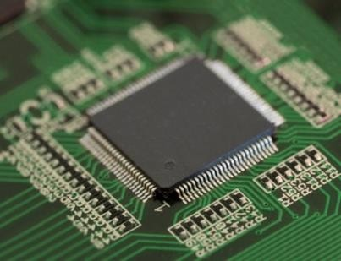
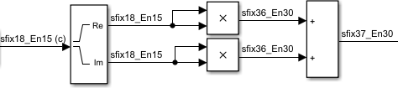
Overview
The steps necessary to implement the algorithm in FPGA hardware, including:
Create a Simulink® model for the algorithm
Implement the hardware architecture
Convert the design to fixed-point
Generate and synthesize the HDL code

Slide 6
Software Requirements
Following MathWorks products:
MATLAB® (R2020b)
Simulink®
Fixed-Point DesignerTM
MATLAB CoderTM
HDL CoderTM
Signal Processing ToolboxTM
DSP System ToolboxTM
EDA Tools
Quartus Prime Pro
ModelSim

Slide 7
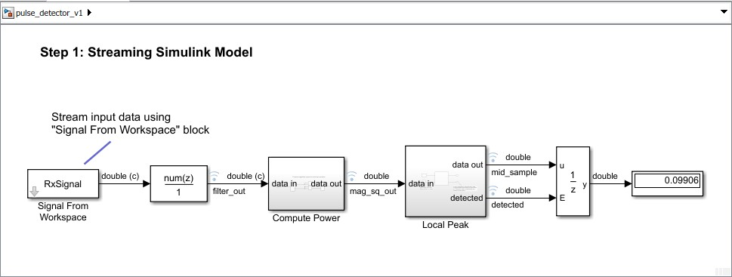
Step 1: Streaming Simulink model
In this step, we will:
Create a Simulink model with streaming input
Implement a hardware-friendly peak finder
Compare the Simulink pulse detector to the MATLAB golden reference

Slide 8
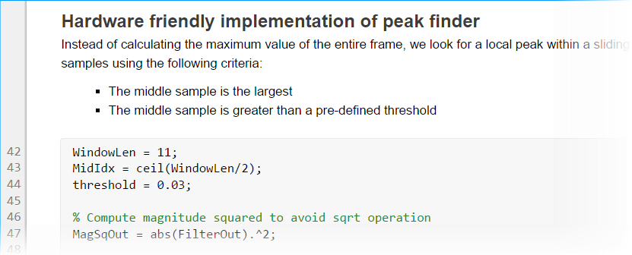
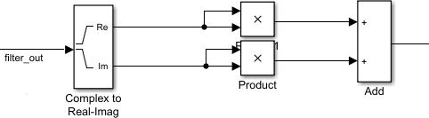

Step 1.1: Hardware-friendly peak finder (magnitude-squared)
At the filter block output, implement magnitude-squared using the following blocks:
Compute power block

Slide 9
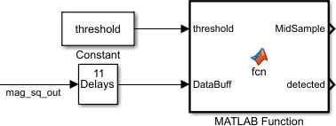
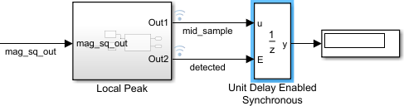
Step 1.2: Hardware-friendly peak finder (local peak)
Add a Constant block and enter threshold for
Constant value.
Connect a Unit Delay Enabled Synchronous block to the subsystem output to “latch” the peak value when detected == 1. Connect the unit delay block to a Display block for visualization.

Slide 10
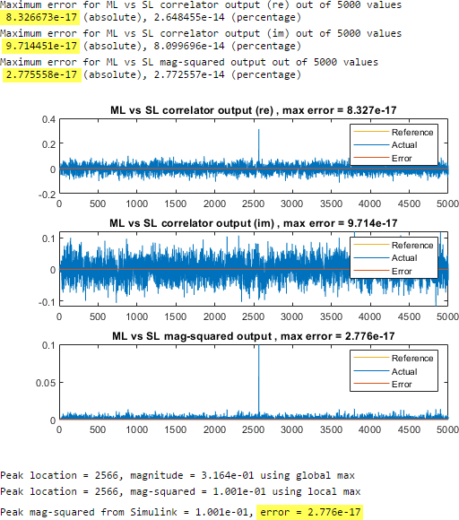
Step 1.3: Compare model to MATLAB reference
Comparing the Simulink outputs to the MATLAB reference.
Maximum error for the correlator, magnitude-squared and peak value should be in the range of floating-point eps (e⁻¹⁶).
Peak location is randomized for each run.
The Simulink model implements a detected output instead of an index for the peak location, as the algorithm is often used to determine the beginning of a data frame, where a detected signal is sufficient.

Slide 11
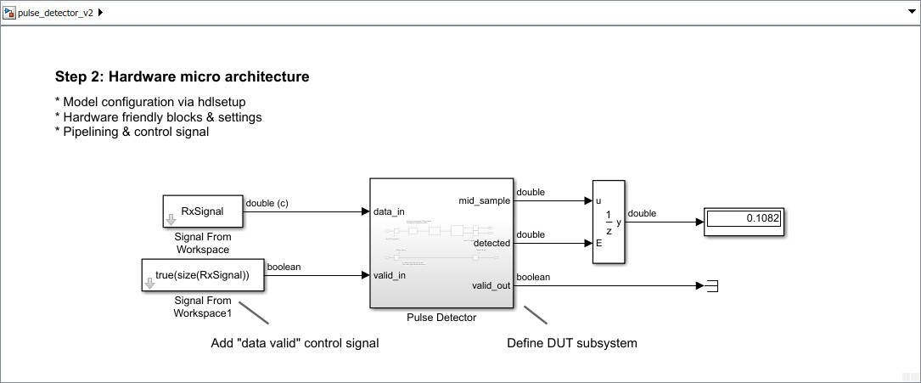
Step 2: Hardware micro architecture
In this step, we will:
Prepare the model for HDL code generation
Add data valid control signal
Use hardware-efficient blocks and pipeline the data path
Compare the Simulink architecture model to the MATLAB golden reference

Slide 12
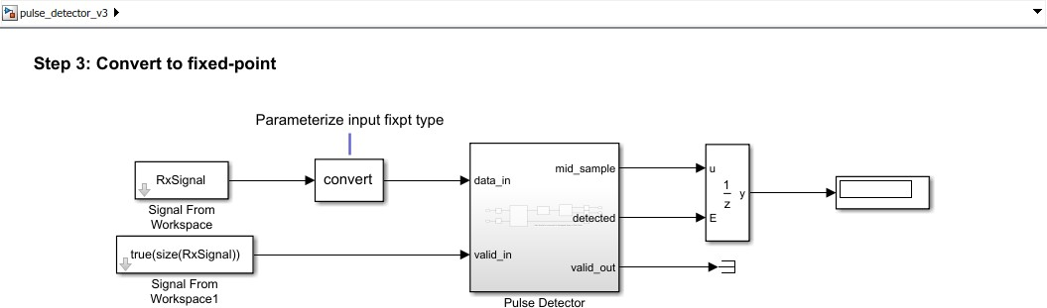
Step 2: Fixed-point conversion
In this step, we will:
Convert the model to fixed-point
Compare the Simulink fixed-point model to the MATLAB golden reference

Slide 13

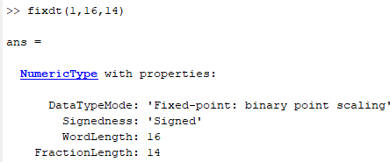
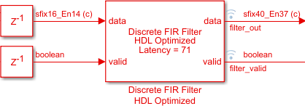
Step 2.1: Define input and filter fixed-point data types
Set Outputdata type to DT_input, which is defined as fixdt(1,16,14) in the test bench script to fully represent -1 to 1.

Slide 14
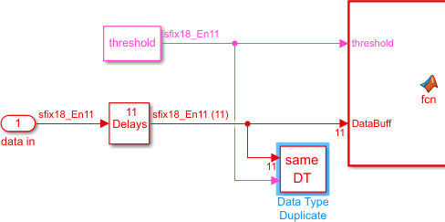

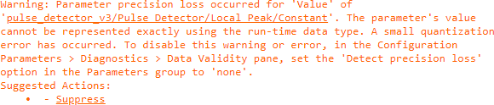
Step 2.2: Define peak picker data types
In the Local Peak subsystem, a Data Type Duplicate block is added. Connect one port to the threshold constant block output, and another to the tapped delay block output.
Set Output data type of the threshold constant to
Inherit via back propagation.
These 2 steps allow the threshold constant to take on the same data type used by the input data.
In the MATLAB function block, change the detected value
to true/false.
Update the model. It should be error-free at this point.
This warning message can be safely ignored or suppressed.

Slide 15
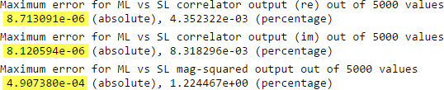

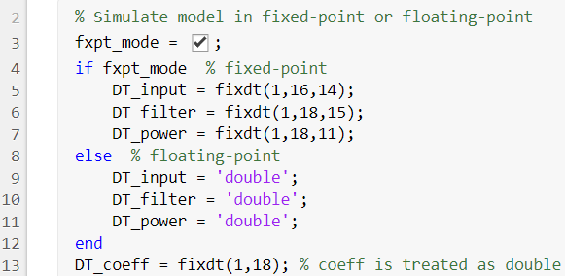
Step 2.3: Compare fixed-point model to MATLAB reference
Run pulse_detector_v3_tb.mlx to simulate the model, and compare the Simulink fixed-point outputs to the MATLAB floating-point reference.
Note the increase in error due to quantization.
You may switch between fixed-point and floating-
point using the following flag in the test bench.
Note: Doing hardware architecture design before fixed-point conversion prevents quantization noise from obscuring design errors.

Slide 16
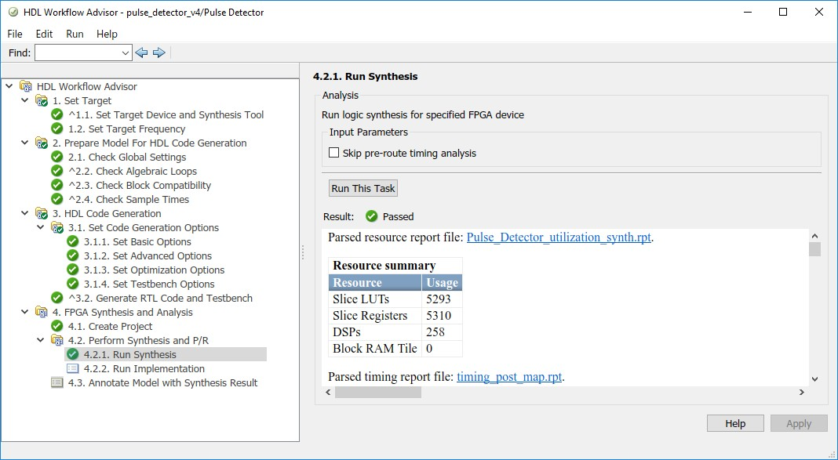
Step 3: HDL code generation & synthesis
In this step, we will:
Check the model for HDL compatibility
Generate HDL code and reports
Synthesize the generated design using Quartus Prime

Slide 17
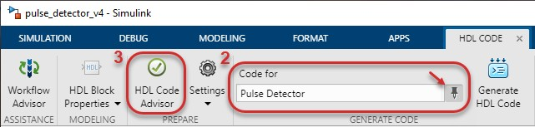
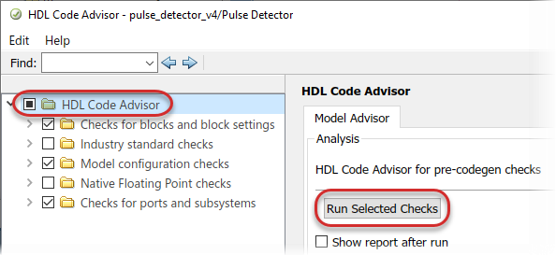
Step 3.1: Check model for HDL compatibility
Check HDL Compatibility for the DUT subsystem using HDL Code Advisor. Besides incompatibility, the tool also checks for settings that may result in inefficient hardware. In many cases, a shortcut is provided to modify those settings.
Check for infinite and continuous sample time sources reports the use of inf sample time by the threshold constant block. Replacing it with back propagation (-1) will allow optimization features such as delay balancing to function properly. Click Modify Settings to apply the fix automatically.

Slide 18
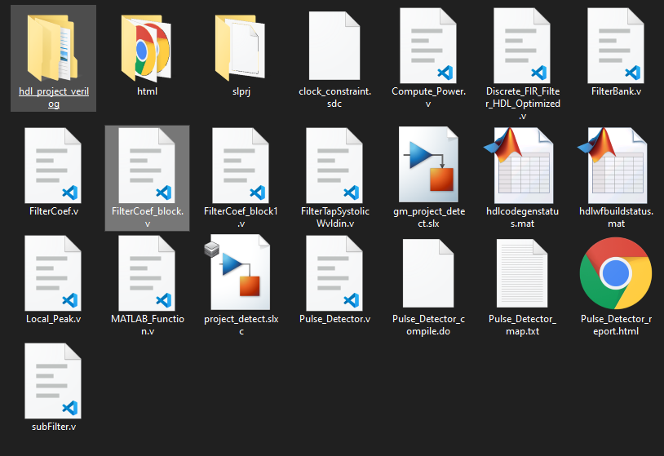
Output of HDL Coder:
We Get:
Verilog codes of top and sub models
Error report
Components of the project

Slide 19
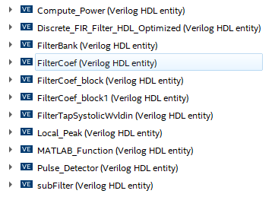
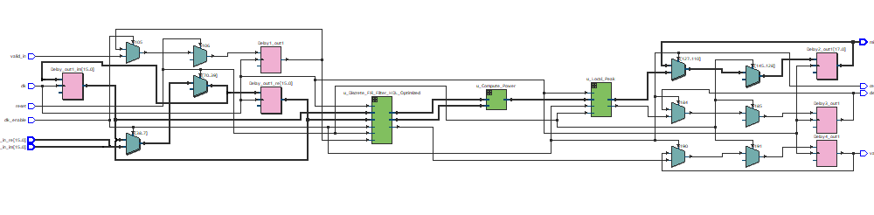
Step 4 :RTL Design of Modules
Using Quartus Prime to get the RTL Design of Verilog Codes

Slide 20
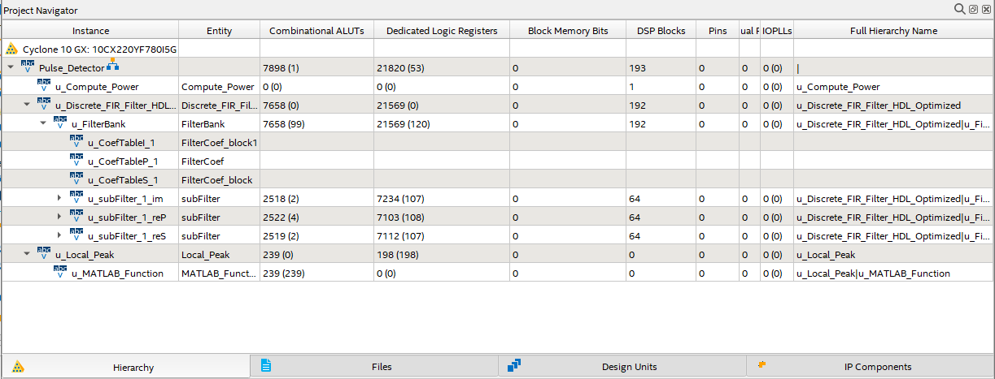
Modules hierarchy and resource utilization:

Slide 21
Conclusion
In this project I have analyzed the strength of MATLAB and Simulink and created the Simulink model of the pulse detection algorithm.
Introduced design architecture options that takes a control over speed and area trade-offs and converted the Simulink design to fixed point.
Have generate and synthesize the optimized HDL code. Report generation are done in the HDL code generation
Have successfully generated and synthesized the optimized HDL code for the pulse detection algorithm implemented in MATLAB.

Slide 22
Future Scopes
Using System Verilog and methodologies like UVM the verification can be done.
After which synthesis can be done once STA is done.
On completion of the above steps, the design can be pushed on to the back end.
On completion of the 8 stages of back end, the GDSII file is generated which can be sent to the foundry

Slide 23
References:
https://www.mathworks.com/matlabcentral/fileexchange
https://www.mathworks.com/help/fixedpoint/ug/view-fixed-point-number-circles.html
http://msdl.cs.mcgill.ca/people/mosterman/presentations/date07/tutorial.pdf
https://www.microsemi.com/document-portal/doc_view/131619-modelsim-user
https://www.mathworks.com/help/hdlcoder/ug/system-design-with-hdl-code-generation-from-matlab-and-simulink.html
https://www.techsource-asia.com/generating-hdl-code-from-simulink
https://www.matlabexpo.com/content/dam/mathworks/mathworks-dot-com/images/events/matlabexpo/in/2017/accelerating-fpga-asic-design-verification.pdf

Slide 24
Thank you
Entire code and output files are available @
https://github.com/raja-aadhithan/RTL-design-for-MATLAB-model

